Slide 1


SmartBins
An automatic and informative waste management system.

Slide 2

Is Waste Management a challenge in India?
ANALYZING THE PROBLEM
As with increasing population, generation of waste is increasing rampantly.
Public dustbins remain uncovered even when not in use.
Breeding of mosquitoes, flies and flues.
Unemptied and overflowing of the garbage bins.
Tedious process for segregation of waste.
High requirement of human labor.
Mis-categorizing the waste.

Slide 3
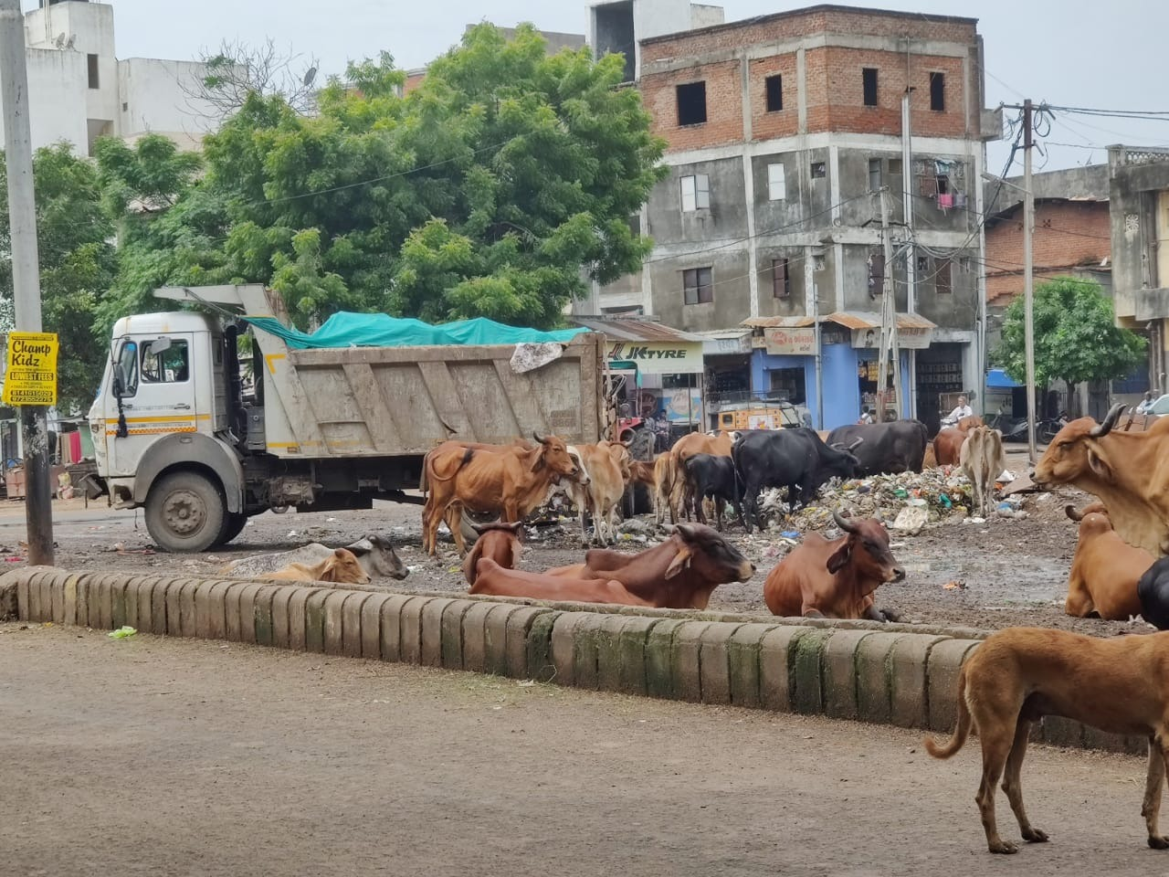
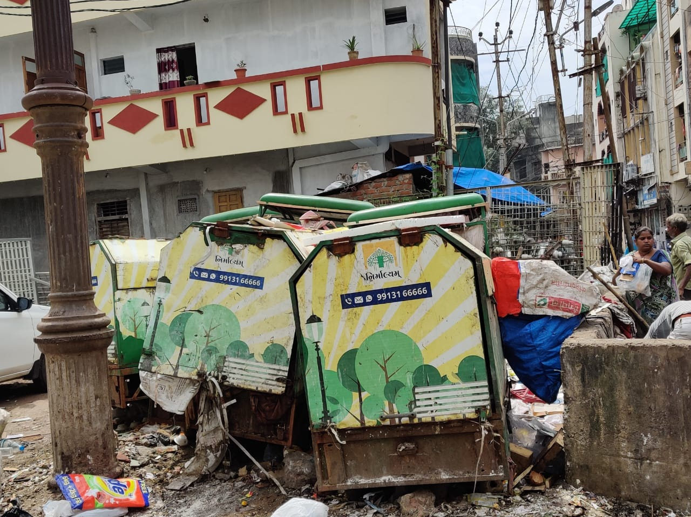
On Ground Survey

Slide 4
Literature Review
IoT Module
Using microcontroller and sensors
Machine Learning Module
Algorithm used: CNN, ANN, SVM, etc.
Module used: GSM module, Wi-Fi module, and cloud computing
Scaled dataset needed
Focused mainly on Plastic and Cardboard segregation.

Slide 5
Recent Progress
As we have seen around there is no such cleanliness maintained when it comes to public area dustbins.
It uses more human labor for the waste management.
No such technology is used which could reduce the time and effort of waste management with limited or less human interaction.
As more human labor is involved in the waste collection and segregation processes, seeing the present scenario of Covid-19 it might involve more health risks.

Slide 6

Our Vision
This automated system helps to maintain the sanity around us.
It would help in reducing the problem of littering due to overflowing of dustbins in the cities.
The segregation of the waste from the heaps of garbage in the dump yard will easily help distinguish the waste which are organic, non-organic, plastic and recyclable.
It will reduce the human efforts and time in the waste management processes.
It will be compatible and Low-cost effective for the convenient use of people.
SmartBins is an innovative idea which would somehow help in the development of a ‘Smart City’, that can be a contribution to ‘Swachh Bharat Abhiyaan’.

Slide 7
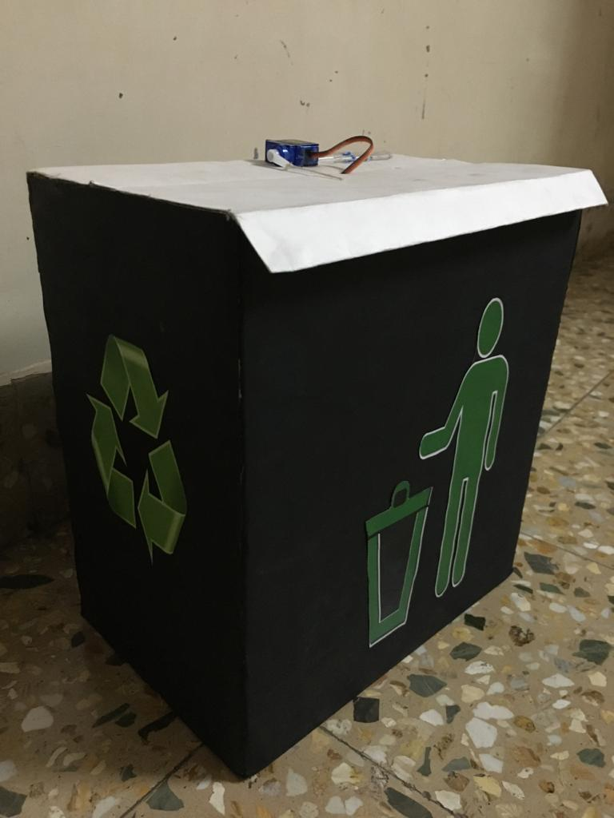
Design of Modules
Broadly classified into two modules
IoT implementation for SmartBins
Machine Learning Algorithm for Waste Segregation

Slide 8
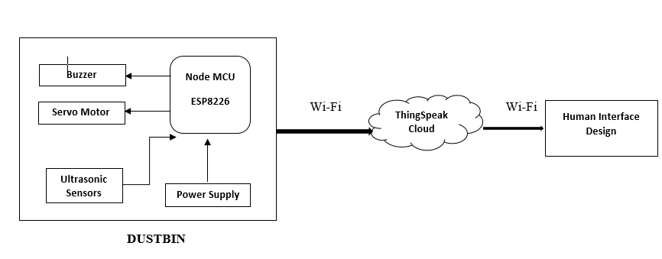
IoT Module

Slide 9
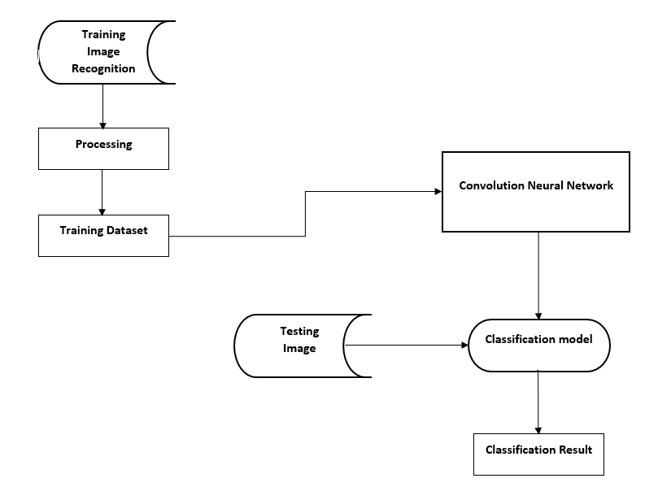
Waste Segregation Module

Slide 10
Social Impacts
As the lid is closed 24*7, the sanity is maintained.
As there is no human interaction in the process, this can help in taking precaution against various diseases like in present scenario, Covid’19.
Timely collection of waste will ensure that dustbin is not overflowing, and will reduce the amount of littering around the bin.
Implementing our project takes us one step towards environment sustainability.
Waste segregation helps in proper disposal of waste according to their category. To exemplify paper is classified into recyclable waste so that it can be resent for recycling.
The system reduces the human effort and time required to complete the job.

Slide 11
Constraints
Maintenance of the system will be quite expensive
Damage to the component might lead to inactivity of the whole system
For higher accuracy, we need dense dataset that includes more images and more time for training.
Due to interrelation of categories, the model might get confused; resulting into unexpected categorization.

Slide 12
Adaptation and Scalability
Major contribution for Swachh Bharat Abhiyaan and an attraction for Smart City.
More number of waste segregation category.
Making the dataset denser, to achieve higher accuracy.
Can be commercialized.
In cooperation of Attendance System in SmartBins.

Slide 13
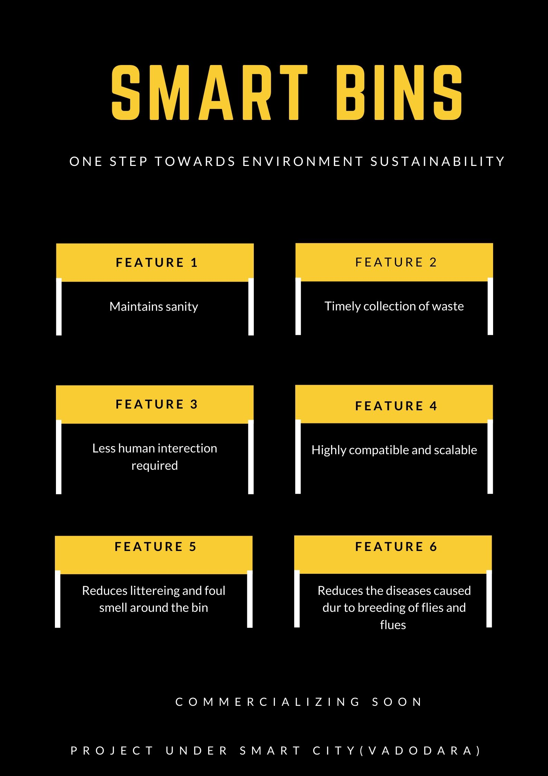
POSTER

Slide 14
The People Behind SmartBins
BHUMI PATEL- 16103466
MARYA GANDHI- 16103468
NIDHI GANDHI- 16103478
ZEEL PARMAR- 16103496

